Slide 1
Презентация краткосрочного курса «Web-surfing»
в рамках семинара
«Формирование межкультурной компетентности обучающихся путем создания иноязычной среды в общеобразовательной школе» (19 февраля 2014 г.).
Автор: Расторгуев Максим Владимирович

Slide 2
What global event was
the main newsmaker this month?

Slide 4
The Olympic Games in Sochi!
Today your task is to find out about the
history of Olympics

Slide 5
And we will start with associations

Slide 6
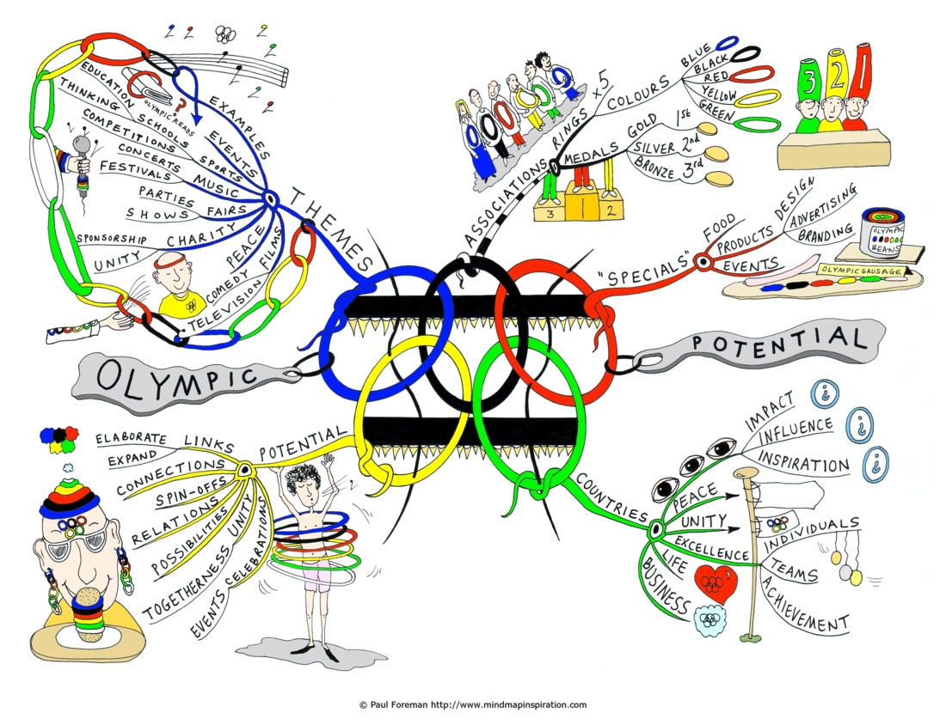

Slide 7
Now look at the table. As you can see some fields are empty. Complete the table, using
World Wide Web

Slide 8
In ____ the first Olympic Games were held at Olympia in Greece
In 394 the Roman Emperor _______ canceled the games
In 1896 the first modern Olympic Games were held in ________
In ____ gold, silver and bronze medals were introduced
In 1914 __________ designed the Olympic symbol of 5 interlocking rings
In ____ the first Winter Olympics were held in Chamonix, France
In 1928 the Olympic flame was lit for the first time in ___________
In ____ the first Olympics were held in Moscow
In 1996 _________ was a major sponsor of the Olympic games in Atlanta
43 world records and 132 Olympic records were broken during the 2008 Summer Olympic Games in _______
In ____ the first Winter Olympics were held in our country. Go Russia!

Slide 9
Cooperate with your classmates,
and make the timeline.
Use the magnets

Slide 10
Find on the map these
Olympic places. Use stickers

Slide 11
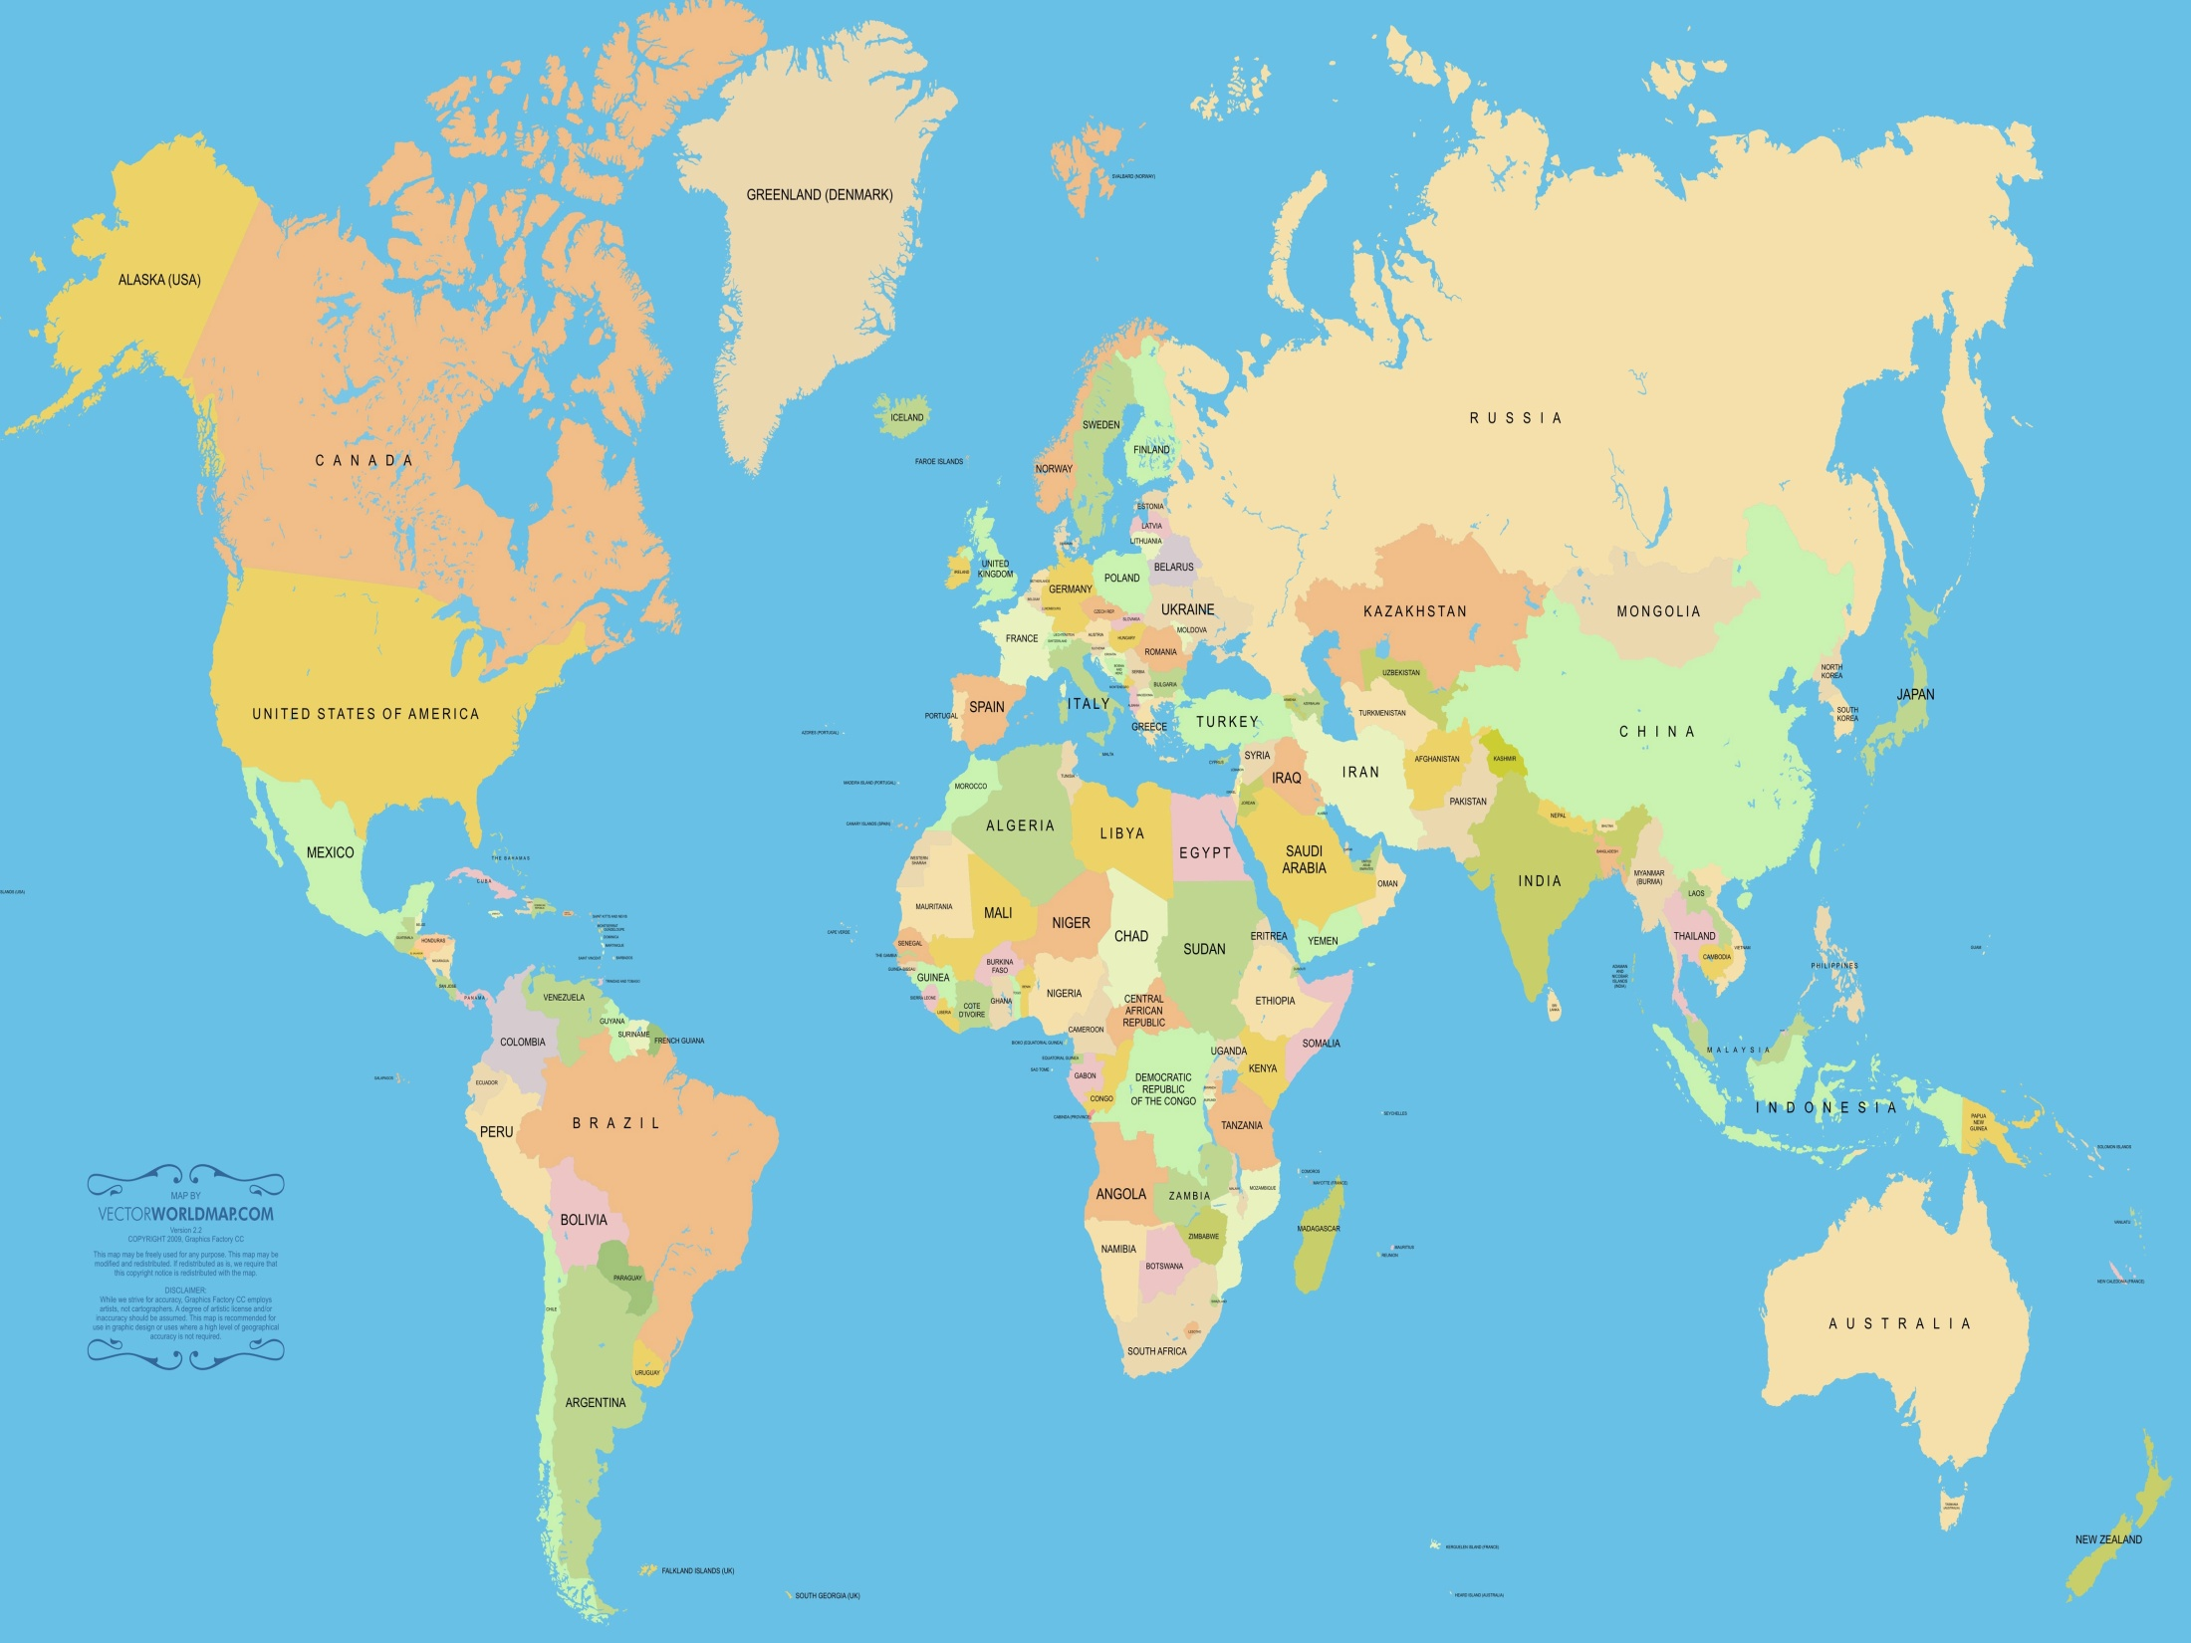

Slide 12
Well done!

