Slide 1
Оценка репрезентативности текстовых корпусов
Смирнова Е.А.,
к. филол.н.,
доцент деп. ин.яз.
НИУ ВШЭ

Slide 2
Corpus -
“[a] collection of texts assumed to be representative of a given language, dialect, or other subset of a language, to be used for linguistic analysis” (Francis 1982)
“a corpus is not simply a collection of texts. Rather, a corpus seeks to represent a language or some part of a language” (Biber et al. 1998)
“a finite-sized body of machine-readable texts sampled in order to be maximally representative of the language variety under consideration” (McEnery/Wilson 2001 [1996]: 24)

Slide 3
Representativeness -
the extent to which a sample includes the full range of variability in a population
(Biber 1993: 243)

Slide 4
Variability -
situational (the range of text types in a language)
linguistic (the range of linguistic distributions in a language)
Target population –
Boundaries of population (what texts are included and excluded)
Hierarchical organisation (what text categories are included)
(Biber 1993: 243)

Slide 5
Qualitative representativeness
Clear design criteria:
Monolingual / bilingual / multilingual
Full texts / text segments
Homogenous / heterogeneous in genre and topic
Compilation protocol:
Finding data
Downloading
Formatting
Storage
(Seghiri 2014: 86)

Slide 6
Quantitative representativeness
Minimum size recommendations:
Sinclair (2004): a corpus should be “big”
McEnery, Wilson (2006 [2000]), Borja-Albi (2000) Ruiz Anton (2006): ~ 1mln words
Friedbichler, Friedbichler (2000): 500 000 – 5mln words (depending on the target field)
Bowker, Pearson (2002): a few thousand – a few hundred thousand words (for study of languages for specific purposes)
Haan (1989, 1992): 20 000 words
Biber (1993): 10 texts

Slide 7
Quantitative representativeness
2. Analyses of the parameters of variation
n = s²/(te/t)²
where: n - computed sample size
s – estimated SD for the population
te – tolerable error (1/2 of the desired confidence interval)
t – t-value for the desired probability level

Slide 8
Problems
Estimation of tolerance error
Estimation of standard deviation
Number of variables
(Biber 1993: 253)

Slide 9
Quantitative representativeness
3. Analysis of lexical density
Tokens – total number of words in a text
Types – total number of distinct words without repetitions
Types / Tokens = Frequency
Ranking – ordering words according to frequency
Zipf’s Law:
The higher a rank number of a word, the lower its frequency - an idea of the breadth of vocabulary

Slide 10
N-Cor – angorithm which represents increases in the corpus (C) on a document by document (d) basis:
Cn =d1+d2+d3+…+dn
Idea (Biber 1993, Perez, Gomez 1998):
the number of types does not increase in proportion to the number of words the corpus contains, once a certain number of texts has been achieved
Notes:
does

Slide 11
ReCor – app which facilitates the evolution of representativeness of corpora in relation to their size
http://www.lexytrad.es/en/resources/recor-3/
the number of files selected is shown on the horizontal axis, while the vertical axis shows the types/tokens ratio

Slide 12
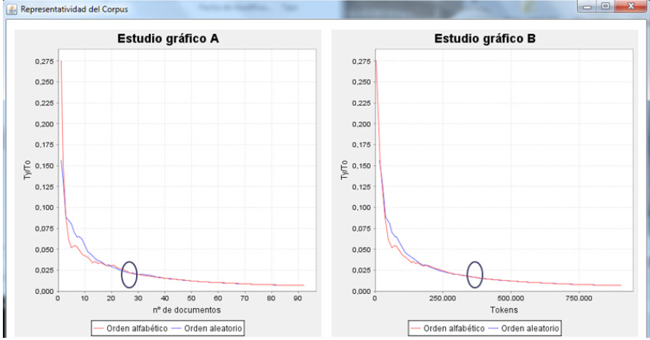
Re-Cor

Slide 13
Our Corpora
 | Learner Corpus | Reference Corpus
Number of Documents | 58 | 62
Number of Words | ~ 130 000 | ~ 694 000

Slide 14
References
Francis, W. Nelson 1982: Problems of assembling and computerizing large corpora. In Stig Johansson (ed.), Computer Corpora in English Language Research. Bergen: Norwegian Computing Centre for the Humanities, 7-24.
Biber, Douglas/Conrad, Susan/Reppen, Randi 1998 (eds): Corpus Linguistics: Investigating Language Structure and Use. Cambridge: Cambridge University Press.
McEnery, Anthony/Wilson, Andrew 2001 [1996]: Corpus Linguistics. Edimburgo: Edinburgh University Press.
Biber, Douglas 1993: Representativeness in Corpus Design. In Literary and Linguistic Computing 8 (4), 243-257.
Seghiri, Miriam 2014. Too Big or Not Too Big: Establishing the Minimum Size for a Legal Ad Hoc Corpus. HERMES-Journal of Language and Communication in Business, 27(53), 85-98.

Slide 15
Sinclair, John M. 2004: Corpus and Text: Basic Principles. In Wynne, Martin (ed.), Developing Linguistic Corpora: a Guide to Good Practice. Oxford: Universidad de Oxford.
McEnery, Anthony/Wilson, Andrew 2006 [2000]: ICT4LT Module 3.4. Corpus linguistics [online]. <http://www.ict4lt.
org/en/en_mod3-4.htm>.
Borja Albi, Anabel 2000: El texto jurídico inglés y su traducción al español. Barcelona: Ariel.
Ruiz Antón, Juan C. 2006: Corpus y otros recursos lingüísticos. Castellón: UJI.
Friedbichler, Ingrid/Friedbichler, Michael 2000: The Potential of Domain-Specifi c Target-Language Corpora for the
Translator’s Workbench. In Bernardini, Silvia/Zanettin, Federico (eds.), I corpora nella didattica della traduzione. Corpus Use and Learning to Translate. Bolonia: CLUEB.
Bowker, Lynn/Pearson, Jennifer 2002: Working with Specialized Language: A practical guide to using corpora.
London: Routledge.
Haan, Pieter de 1989: Postmodifying clauses in the English noun phrase. A corpus-based study. Amsterdam: Rodopi.
Haan, Pieter de 1992: The optimum corpus sample size? In Leitner, Gerhard (ed.), New dimensions in English language
corpora. Methodology, results, software development. Berlin/New York: Mouton de Gruyter, 3-19.

Slide 16
Спасибо за внимание!

