Slide 1


Uncertainty of Outcome and Attendance:
Evidence from Russian Football
Kseniya Baidina
National Research University Higher School of Economics
Petr Parshakov
International Laboratory of Intangible-driven Economy
National Research University Higher School of Economics

Slide 2



Introduction
What do you want, fans?
Divergent results about the connection between attendance and uncertainty

Slide 3

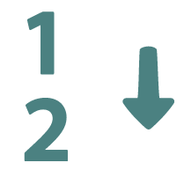
Literature Review
Approaches to measure outcome uncertainty (Borland and Macdonald, 2003):
Through the difference in league positions or the share of won games
Through betting odds

Slide 4
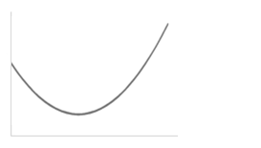
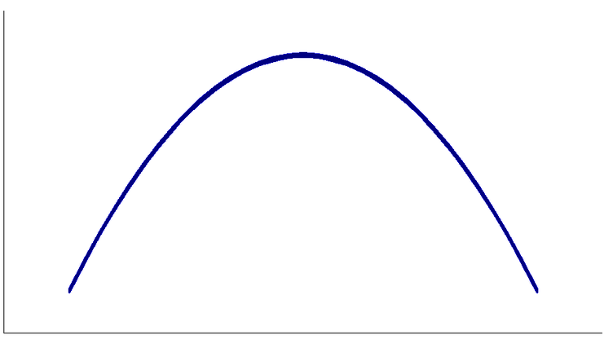
Literature Review
Inverted U-shaped curve
U-shaped curve
Attendance
Attendance
0,66
Home win probability
Home win probability
(Szymansky (2003), Borland and Macdonald (2003))
(Peel and Thomas (1992), Forrest and Simmons (2002), Forrest et al. (2005), etc.), Coates et al. (2014))

Slide 5
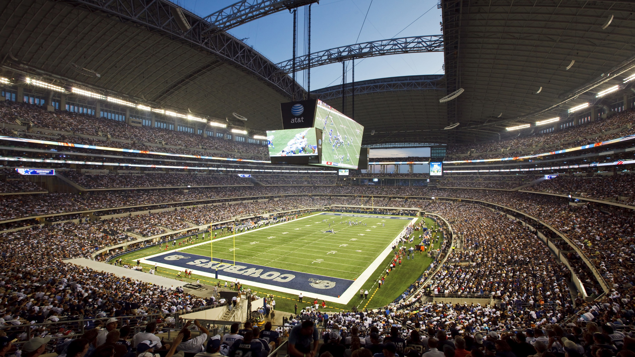
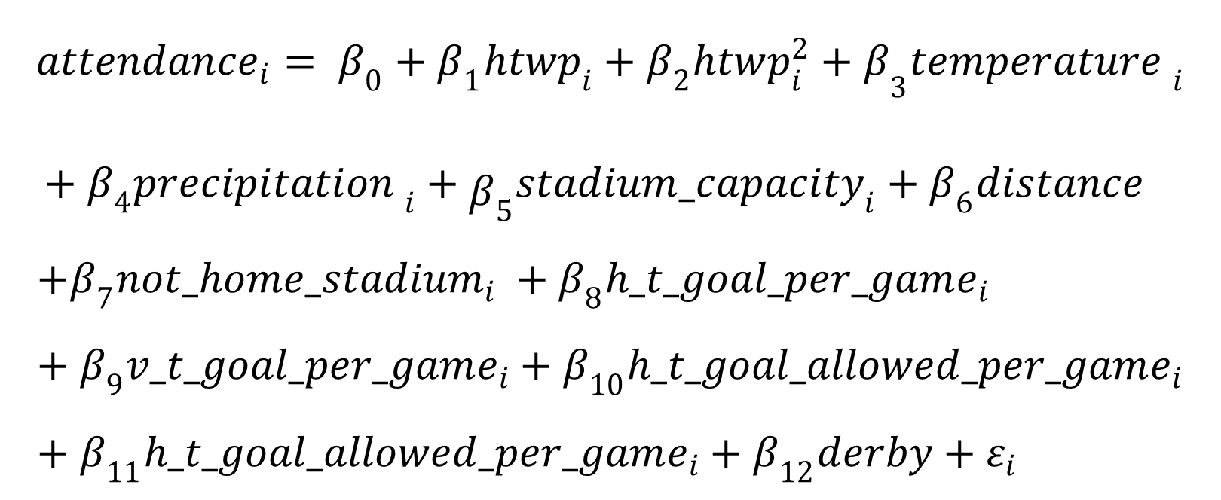
Methodology
$${attendance}_{i}= β_{0}+β_{1}htwp_{i}+{β_{2}htwp_{i}^{2}+β}_{3}{temperature }_{i}$$
$${+ β_{4}{precipitation }_{i}+{\begin{aligned} \\ β\end{aligned}}_{5}{stadium_capacity}_{i}+β_{6}distance}_{}$$
$${+β}_{7}not_home_{stadium}_{i} +β_{8}h_t_goal_per_game_{i}+β_{9}v_t_goal_per_game_{i}+β_{10}h_t_goal_allowed_per_game_{i}+β_{11}h_t_goal_allowed_per_game_{i}+β_{12}derby+ε_{i}$$

Slide 6



Data
The RFPL: 2012-2014
No sellouts
A developing sports market
High uncertainty of outcome

Slide 7
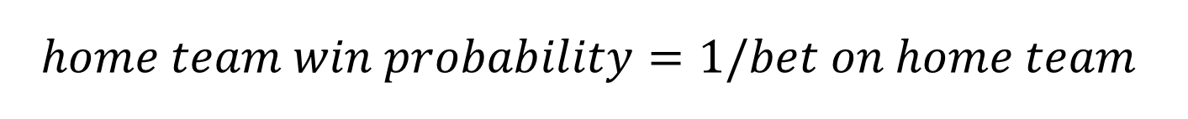
Data
Bet – an indicator that represents the winning amount per one ruble from the bet on a particular team, on condition that this team wins
$$home team win probability=1/bet on home team$$
Distribution of home team winning probability

Slide 8
Descriptive statistics
 | N | Mean | St. Dev. | Min | Max
Temperature | 470 | 13.130 | 9.282 | -12 | 33
Precipitation | 470 | 0.300 | 0.459 | 0 | 1
Attendance | 470 | 12,444 | 6,992 | 1,950 | 67,740
stadium capacity | 470 | 27,245 | 14,588 | 3,000 | 84,745
betting coefficient | 465 | 2.807 | 1.822 | 1.130 | 16.00
distance between cities | 470 | 1,388 | 844.6 | 0 | 4,207
not home stadium | 470 | 0.060 | 0.237 | 0 | 1
home team goals per previous game | 470 | 1.270 | 0.520 | 0.000 | 3.000
visiting team goals per previous game | 470 | 1.301 | 0.522 | 0.000 | 3.000
goals allowed visiting team per previous game | 470 | 1.312 | 0.477 | 0.000 | 2.556
goals allowed home team per previous game | 470 | 1.277 | 0.484 | 0.000 | 3.000
home team winning probability | 465 | 0.462 | 0.197 | 0.062 | 0.885

Slide 9
 | (1) Initial model | (2) Top visiting team | (3) Top visiting team and low home team | (4) Low home team | (5) Initial model with home team dummies | (6) Initial model with visiting team dummies | (7) Initial model with all teams dummies
home team winning probability | -22,861.9*** (6,843.895) | -77,261.6** (29,363.970) | -173,877.3** (64,866.330) | -35,577.9*** (10,026.810) | -19,822.6*** (6,048.558) | -4,882.2 (7,374.770) | 2,767.7 (6,538.019)
home team winning probability² | 18,038.33** (7,097.340) | 102,292.5** (44,152.820) | 504,925.0** (167,243.200) | 42,424.7*** (13,230.440) | 12,437.0** (6,256.256) | 8,493.8 (7,192.409) | 1,731.2 (6,130.970)
control variables | included | included | included | included | included | included | included
team dummies |  |  |  |  | home | visiting | both
Observations | 465 | 56 | 22 | 175 | 465 | 465 | 465
R² | 0.374 | 0.637 | 0.835 | 0.556 | 0.588 | 0.454 | 0.667
Adjusted R² | 0.358 | 0.535 | 0.685 | 0.526 | 0.561 | 0.417 | 0.631
Residual Std. Error | 5,584.285 (df = 452) | 5,824.187 (df = 43) | 2,880.994 (df = 11) | 4,047.905 (df = 163) | 4,618.303 (df = 435) | 5,319.024 (df = 435) | 4,234.287 (df = 418)
F Statistic | 22.551*** (df = 12; 452) | 6.278*** (df = 12; 43) | 5.558*** (df = 10; 11) | 18.582*** (df = 11; 163) | 21.431*** (df = 29; 435) | 12.465*** (df = 29; 435) | 18.236*** (df = 46; 418)
F test (home team winning probability = home team winning probability ²=0) | 8.02*** | 3.56* | 5.13* | 6.39** | 9.82*** | 1.48 | 1.15

Slide 10
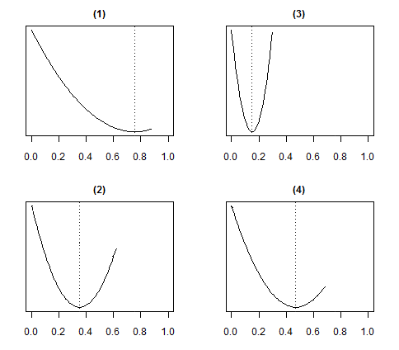
1) Initial model
3) Top visiting team and low home team
X – home team winning probability
2) Top visiting team
4) Low home team
Y - attendance

Slide 11
Findings
The UOH is not for the RFPL
The dependence between attendance and home team winning probability is declining
Attendees like watching top teams despite the level of uncertainty and chances of the home team (in line with Pawlowski and Anders (2012), Coates et al. (2015))

Slide 12


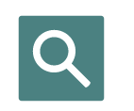

Limitations
Results are not transferrable to the other leagues
No information on the ticket prices
No information about season ticket attendance
More data should be considered

