Slide 1
www.univ-evry.fr

Slide 2
University of Evry-Val d’Essonne
The University of Evry-Val d'Essonne was created in 1991 as part of the development of higher education in the Ile-de-France region.
There are more than 160 curricula: Science, Technology, Law, Economics, Management and the Social Sciences.
18 laboratories and 3 doctoral schools
More than 10 000 students
5 Faculties (or UFR, Unités de Formation et de Recherche), an Engineering School and an Institute for Technology.

Slide 3
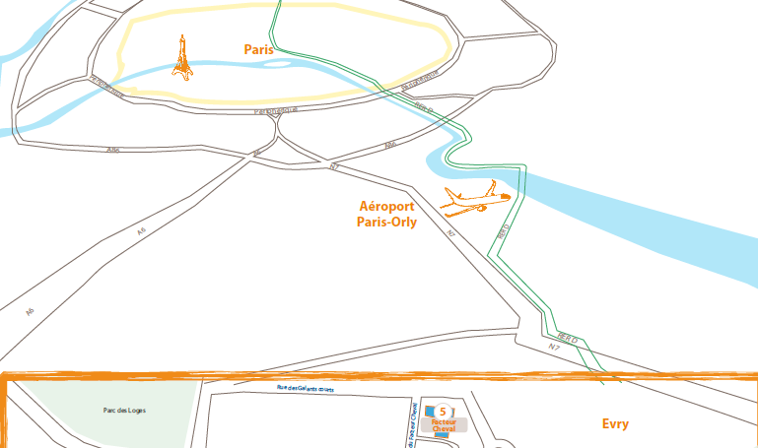
University of Evry-Val d’Essonne: where?

Slide 4
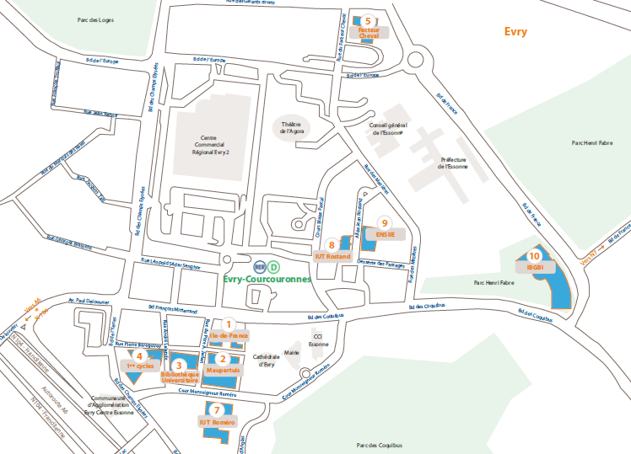
University of Evry-Val d’Essonne: where?

Slide 5
Understanding higher education in France
Higher education in France is organised in three levels which correspond to those of other European countries:
LMD [Licence – Master – Doctorat]
Baccaleauréat + 3 years of validated study = Licence (Bachelor of Arts)
Baccaleauréat + 5 years of validated study = Master (Master of Arts)
Baccaleauréat + 8 years of validated study = Doctorat (Doctorate)

Slide 6
Understanding higher education in France
The Licence and the Master are organised in semesters: 6 for the Licence and 4 for the Master.
These levels of study include various “parcours” or paths based on UE (Unités d’Enseignement or Modules), each worth a defined number of European credits (ECTS). A student “capitalises” these credits which are generally transferable between paths.
A Licence is awarded once 180 ECTS have been obtained. A Master is awarded once 120 additional credits have been obtained.

Slide 7
Economics Department at Evry University
Economics department ensures the full university cycle in economy.
Three years of Bachelor’s Degree in Economics and Management
+ two years of Master Degree in Finance
or two years of Master Degree in Innovation Economics and Society: speciality Innovation, Market and Data Science (IMDS) (new – starting 2015)
The first two years of Bachelor’s Degree are common to Economics and Management. During the third year students choose their specialisation: Economy or several paths in Management.

Slide 8
Economics Department at Evry University
In academic year 2012-2013 we had:
226 students in L1 (first year of Bachelor’s Degree);
93 students in L2 (second year of Bachelor’s Degree);
47 students in L3 specialised in Economics (third year of Bachelor’s Degree);
49 students in M1 (first year of Master Degree);
22 students in M2 “Banking & Finance” (second year of Master Degree)
23 students in M2 “Risk and Asset Management” (second year of Master Degree)

Slide 9
Evry University as a member of Paris-Saclay University
Starting september 2015 Evry University will integrate Paris-Saclay University
What is Paris-Saclay?
A French “mega University” which will federate 3 universities, 10 "grandes écoles" and 7 research organizations.
Spring 2014: creation of the university
September 2015: the first academic year: 49 different Master programs
http://www.campus-paris-saclay.fr/en/

Slide 10
Evry University as a member of Paris-Saclay University
http://www.campus-paris-saclay.fr/en

Slide 11
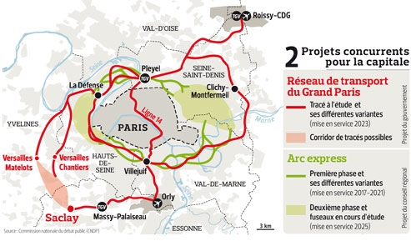
Evry University as a member of Paris-Saclay University
http://www.campus-paris-saclay.fr/en

Slide 12
Why to study in France
For the quality of its system of higher education
To experience the unique French "art of living“
Finally price (!)
Annual tuition rates at public institutions are set by law. The rates for the 2014–15 academic year are, by degree program:
€189,10 for licence programs
€261,10 for master's programs
€396,10 for doctoral programs
+ 213 € of social security
Competitive prices of housing, especially student residencies (€ 300-600 in Evry)
http://www.campusfrance.org/en /

Slide 13
Bachelor’s degree Year 1
Semester 1
Block | Course | ECTS | Coef. | Lect. | Tut. | Lect-Tut
Fundamental teachings | Principles of macroeconomics 1 | 11 | 5,5 | 36 | 18
 | Principles of microeconomics 1 |  | 5,5 | 36 | 18
Methodological teachings | Mathematics 1 | 5 | 5 |  |  | 54
Disciplinary teachings | Introduction to management | 8 | 5 | 36
 | History of economic events 1 |  | 3 | 18
Complementary teachings | Introduction to law | 6 | 4 | 36
 | English 1 |  | 2 |  | 18
Total Semester 1 |  | 30 | 30 | 162 | 54 | 54
Semester 2
Block | Course | ECTS | Coef. | Lect. | Tut. | Lect-Tut
Fundamental teachings | Principles of macroeconomics 2 | 10 | 5 | 36 | 18
 | Principles of microeconomics 2 |  | 5 | 36 | 18
Methodological teachings | Mathematics 2 | 8 | 5 |  |  | 36
 | Descriptive statistics |  | 3 | 18 | 18
Disciplinary teachings | Introduction to accounting | 6 | 4 |  |  | 36
 | Money, banks and financial markets |  | 2 | 18
Complementary teachings | Information technology 1 (C2i) | 4 | 2 |  | 18
 | English 2 |  | 2 |  | 18
Opening and vocational teachnings | Free teaching unit | 2 | 2 | 18
Total Semester 2 |  | 30 | 30 | 126 | 90 | 72

Slide 14
Bachelor’s degree Year 2
Semester 3
Block | Course | ECTS | Coef. | Lect. | Tut. | Lect-Tut
Fundamental teachings | Elementary macroeconomics 1 | 10 | 5 | 36 | 18
 | Elementary microeconomics 1 |  | 5 | 36 | 18
Methodological teachings | Mathematics 3 | 6 | 3 |  |  | 36
 | Elementary statistics |  | 3 |  |  | 36
Disciplinary teachings | General accounting | 7 | 3 |  |  | 36
 | History of economic events 2 |  | 2 | 18
 | Organisation of businesses |  | 2 | 18
Complementary teachings | Information technology 2 (C2i) | 4 | 2 |  | 18
 | English 3 |  | 2 |  | 18
Opening and vocational teachnings | Personal and professional project | 3 | 1
 | Free teaching unit |  | 2 | 18 | 9
Total Semester 3 |  | 30 | 30 | 126 | 81 | 108
Semester 4
Block | Course |  | Coef. | Lect. | Tut. | Lect-Tut
Fundamental teachings | Elementary macroeconomics 2 | 10 | 5 | 36 | 18
 | Elementary microeconomics 2 |  | 5 | 36 | 18
Methodological teachings | Mathematics 4 | 6 | 3 |  |  | 36
 | Intermediary statistics |  | 3 |  |  | 36
Disciplinary teachings | Analytical accounting | 8 | 2 | 18
 | International economics |  | 3 | 36
 | Contemporary economic issues |  | 3 | 18 | 18
Complementary teachings | Business law | 4 | 2 | 18
 | English 4 |  | 2 |  | 18
Opening and vocational teachnings | Free teaching unit | 2 | 2 | 18
Total Semester 4 |  | 30 | 30 | 180 | 72 | 72

Slide 15
Bachelor’s degree Year 3: Economics
Semester 5
Block | Course | ECTS | Coef. | Lect. | Tut. | Lect-Tut
Disciplinary teachings in Economy | Intermediate macroeconomics | 9 | 5 | 36 | 18
 | Market structure and industrial organisation |  | 4 | 36
Methodological teachings | Mathematics 5 | 7 | 3 | 18 | 18
 | Introduction to econometrics |  | 4 | 24 | 18
Disciplinary teachings of Management | Company law | 9 | 2 | 15
 | Financial analysis |  | 3 | 15 | 15
 | Human resources management and labour law |  | 4 | 20 | 10
Complementary teachings | Introduction to finance | 5 | 3 | 36
 | English 5 |  | 2 |  | 18
Total Semester 5 |  | 30 | 30 | 200 | 97
Semester 6
Block | Course | ECTS | Coef. | Lect. | Tut. | Lect-Tut
Disciplinary teachings in Economy | Intermediate macroeconomics 2 | 10 | 5 | 36 | 18
 | Intermediate microeconomics 2 |  | 5 | 36 | 18
Methodological teachings | Financial Mathematics | 7 | 3 | 18 | 18
 | Elementary econometrics |  | 4 | 24 | 18
Specific teachings in economy. Two courses to be chosen from the following: | Environmental economics (24 Lect.) | 7 | 3,5
 | Game theory (24 Lect.)
 | Development and inequality (24 Lect.) |  | 3,5
 | Tutored project (7,5 Tut.)
Complementary teachings | History of economic thinking | 6 | 4 |  |  | 48
 | English 6 |  | 2 |  | 18
Total Semester 6 |  | 30 | 30 | 114 | 90

Slide 16
Master Finance http://master-finance-evry.fr/ University of Evry Val d’Essonne Fabrice PANSARD, director fabrice.pansard@univ-evry.fr

Slide 17
Master finance – Contacts M2
Administration
Mme Leila CHOUGUI
Bât. Ile de France – Bureau 346 bis
Tel. 01.69.47.90.27
E-mail : leila.chougui@univ-evry.fr
Banking & Finance
Catherine Guidez
Economics Department
Bât. Ile de France – Bureau 340
E-mail : catherine.guidez@univ-evry.fr
Risk and Asset Management
Juliana Caicedo-Llano
Economics Department
Bât. Ile de France – Bureau 346
Mèl : juliana.caicedollano@univ-evry.fr
Director of the Master
Fabrice Pansard
Economics Department
Bât. Ile de France (IDF)– Bureau 300
fabrice.pansard@univ-evry.fr

Slide 18
Master Finance

Slide 19
Master finance M1
SEMESTER 1 (Autumn term) |  | SEMESTER 2 (Winter term)
UE1 : Economics/Management |  | UE4 : Finance
Microeconomics of risk and uncertainty |  | Financial markets and asset valuation
Monetary and Financial Macroeconomics |  | Portfolio Management
Strategic Management |  | Corporate Financial policy
Information systems |  | Financial analysis tools
UE2 : Quantitative Techniques |  | UE5 : Optional courses (3 of 7)
Financial Mathematics |  | Advanced accounting
Statistics and data analysis |  | Corporate taxation
Programming for finance |  | Introduction to financial econometrics
 |  | Probability approach in finance
UE3 : Complements |  | Bank economics
English for Finance |  | International Finance
English: preparation to TOEIC |  | Research seminar
Financing Law
Business Ethics |  | UE6 : Professional/Internship/Thesis
 |  | Professionalization seminar
 |  | Internship thesis or research thesis

Slide 20
Master finance M2
SIF (Strategy and Financial Engineering ) |  | BF (Banking & Finance) |  | GRA (Risk and Asset Management)
SEMESTER 3 |  | SEMESTER 3 |  | SEMESTER 3
UE1 : Financial strategies environment |  | UE1 : Environment of BF |  | UE1 : Environment of GRA
Financial Instruments and Markets* |  | Economic conjuncture * |  | Economic conjuncture *
Consolidated corporate taxes |  | Strategies of banks and financial institutions |  | Capital markets and financial instruments**
Capital-risk* |  | Capital markets and financial instruments** |  | Monetary policy and financial markets
Risk Management
UE2 : Financial Engineering (corporate)** |  | UE2 : Financial Engineering (corporate)** |  | UE2 : Quantitative technics
Advanced financial diagnostics |  | Advanced financial diagnostics |  | Time series Econometrics
Corporate valuation |  | Corporate valuation |  | Numerical methods and programming**
Programming for finance |  | Programming for finance |  | Stochastic calculus
 |  |  |  | Information systems/databases**
UE3 : Strategic and accounting actions of groupings |  | UE3 : Financing |  | UE3 : Risk Management/Insurance
Strategies of groups |  | Instruments of financing and coverage |  | Risk management**
Organization and management account of groups |  | Banks financing |  | Insurance
Mergers & Acquisition |  | Capital-risk * |  | Systemic risk
SEMESTER 4 |  | SEMESTER 4 |  | SEMESTER 4
UE4 : Language |  | UE4 : Language |  | UE4 : Language
English for finance |  | English for finance |  | English for finance
English: TOIEC preparation ***** |  | English: TOIEC preparation *** |  | English: TOIEC preparation ***
UE5 : Internationalization of activities |  | UE5 : Banking Management |  | UE5 : Asset Management
International taxation |  | Banking risk management |  | Portfolio management
Consolidation of accounts |  | Asset/Liability Management |  | Strategic Allocation
Norms IFRS |  | Banking marketing |  | Risk parity
 |  | Bank internal audit & control
UE6 : Professional/Internship/Thesis
Professionalization seminar*** |  | UE6 : Professional/Internship/Thesis*** |  | UE6 : : Professional/Internship/Thesis***
Internship thesis or research thesis |  | Professionalization seminar |  | Professionalization seminar
 |  | Internship thesis |  | Internship thesis

Slide 21
Master finance – Calendar M2
Autumn term - Semester 1 (October - December)
Winter term - Semester 2 (January - March)
Search of Internship period (Avril –internship min 4 months)
Internship and thesis (defense of a thesis before mi-November)

Slide 22
Master finance – Joint activities of M2
English courses
Formation Reuters and rooms access
Presentation of professional certifications (February)
Alumni meeting (March)

Slide 23
Master finance M2 GRA
Joint courses with M2 IF (Financial engineering) of mathematical department
Certifications (AMF - Reuters)
Importance of internship and internship thesis (6 months between 1/04 and 30/11).
Possible internships:
Newedge : Credit risks client corporate
CACIB : Credit portfolio management
Axa : Risk management Solvability 2
LCHClearnet : Back and Stress Testing
Labor market insertion: 75% within the 6 months, wage between 35 and 45K€.

Slide 24
Master finance is among 20 Best in France
Risk and Asset Management and Banking & Finance are classified among 20 Best Masters Ranking of France.
The M2 “Banking & Finance” is on the 10th place in 2013 (was on the 14th in 2012) in the category of “Banking & Finance”.
The M2 “Risk and Asset Management” is on the 15th place in 2013 (was on the 17th in 2012) in the category “Financial Markets and Portfolio Management”.
Three principle criteria are at the source of the Best Masters Ranking:
the reputation of the program,
the salary of the 1st employment,
the satisfaction of the students.
http://www.meilleurs-masters.com

Slide 25
Master Innovation, Economics and Society
Speciality: Innovation, Market and Data Science (IMDS)

Slide 26
Master Innovation Economics and Society
This master has fourteen specialities.
One of these specialities is called Innovation, Market and Data Sciences (IMDS).
The master IMDS is for students who wish to gain expertise at the intersection of economic analysis, marketing and quantitative techniques.

Slide 27
Master Innovation Economics and Society
Master 1, Semester 1:
Econometrics: 15h
Data Analysis: 15h
Quantitative Methods: 15h
Industrial Organization: 24h
Innovation Economics: 24h
Management of innovation: 24h
Sociology of innovation: 24h
Rights of contracts and competition: 24h
History of technics and innovation: 24h
English: 30h
Two training courses in SAS software (15h), and R software (15h)

Slide 28
Master Innovation Economics and Society
Master 1, Semester 2:
Theory of firms: 15h
Theory of organizations: 15h
Sociology of consumers: 24h
Microeconometrics: 20h
WEB analytics: 15h
History of science: 30h
English: 30h
Two optional courses : Evironmental economics (20h), Marketing of innovation (20h)
Professional conferences
Intership

Slide 29
Master Innovation Economics and Society
Master 2, Semester 1:
CRM-Customer Relationship Management: 24h
Data and market value creation: 12h
Scoring: 24h
Data mining: 24h
Economics and Innovation Management: 20h
Marketing of innovation: 20h
Digital Marteking: 15h
(…)

Slide 30
Master Innovation Economics and Society
Master 2, Semester 1:
Big data: 24h
Machine learning: 24h
Multi-core system languages (Hadoop, MapReduce,…): 15h
Data Vizualisation: 15h
Professional english: 15h
Project management: 12h
Two training courses in SAS software (24h), and R software (24h)

Slide 31
Master Innovation Economics and Society
Master 2, Semester 2:
Customer satisfaction (quantitative structural models): 24h
Duration Models for marketing: 10h
Geomarketing: 20h
Bank Marketing: 15h
Training for TOEIC: 25h
Online Survey (ASKIA software): 10h
Marketing Games with Markstrat

Slide 32
По всем вопросам:
Ekaterina.Kalugina@univ-evry.fr
kalugkatia@gmail.com

